Slide 1

Software Testing Phase-IV
Javaria Naveed 19L-1229
Zahra Ejaz 19L-2284

Slide 2

Phase-II
UI Testing
Odoo

Slide 3

Steps
docker run -d -e POSTGRES_USER=odoo -e POSTGRES_PASSWORD=odoo -e POSTGRES_DB=postgres --name db -v odoo-db-data:/var/lib/postgresql/data postgres:10
docker run -p 8069:8069 -p 8071:8071 -v odoo-data:/var/lib/odoo -v odoo-custom-addons:/mnt/extra-addons --name odoo --link db:db -t odoo:latest
Docker start db
Docker start odoo
You can also use Docker Desktop Interface to run the images
http://localhost:8069

Slide 4
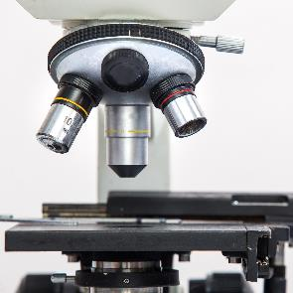

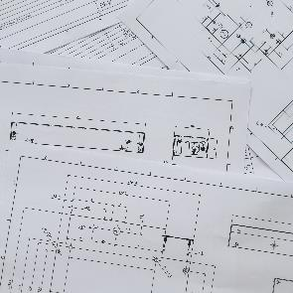



Create Opportunity in CRM
Let’s have a look at the flow
Features file
Steps File:
Login to Odoo
Navigate to CRM
Create Opportunity
Verify it’s created
1
2
3
4
5
6

Slide 5
Phase-III
Unit Testing
Using Python’s unittest Library

Slide 6
Snake Game Overview
Create a Snake Body
Detect Collisions with Food
Move the Snake
Create a Scoreboard
Control the Snake
Detect Collision with Wall
Create Targets
Detect Collision with Tail

Slide 7

Thank You
Any Questions?

